Slide 1
Web Mining

Slide 2
Web Mining
Web mining is a technique to discover and analyze the useful information from the Web related data and services.
According to Etzioni [2], web mining can be divided into four subtasks:(i)
Information Retrieval/Resource Discovery (IR):
Find all relevant documents on the web. The goal of IR is to automatically find all relevant documents, while at the same time filter out the non relevant ones.
Search engines are a major tool people use to find web information.

Slide 3
Web Mining
(ii) Information Extraction (IE):
Automatically extract specific fragments of a document from web resources retrieved from the IR step. Building a uniform IE system is difficult because the web content is dynamic and diverse.
Most IE systems use the “wrapper" [3] technique to extract specific information for a particular site.
Machine learning techniques are also used to learn the extraction rules.
(iii) Generalization:
Discover information patterns at retrieved web sites. The purpose of this task is to study users' behaviour and interest.
Data mining techniques such as clustering and association rules are utilized here
(iv) Analysis/Validation:
Analyze, interpret and validate the potential information from the information patterns.
The objective of this task is to discover knowledge from the information provided by former tasks. Based on web data, we can build models to simulate and validate web information.

Slide 4
Challenges in web mining
Along with opportunities, there are serious challenges in web mining
● Web is noisy : A Web page typically contains a mixture of many kinds of
information, e.g., main contents, advertisements, navigation panels, copyright
notices, etc.
● Web is dynamic : Information on the Web changes constantly. Keeping up
with the changes and monitoring the changes are important issues.
● Web is a virtual society : It is not only about data, information and services,
but also about interactions among people, organizations and automatic
systems, i.e., communities.
● Many other such restrictions pose a pretty big challenge for mining the web.

Slide 5
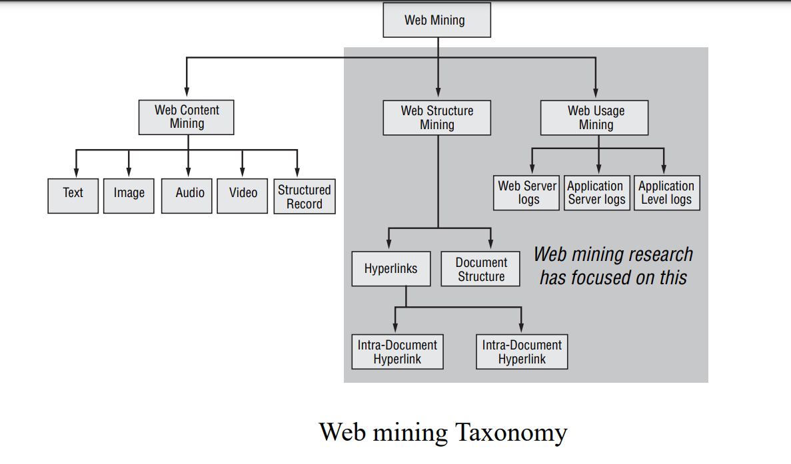
Web Mining Taxonomy

Slide 6
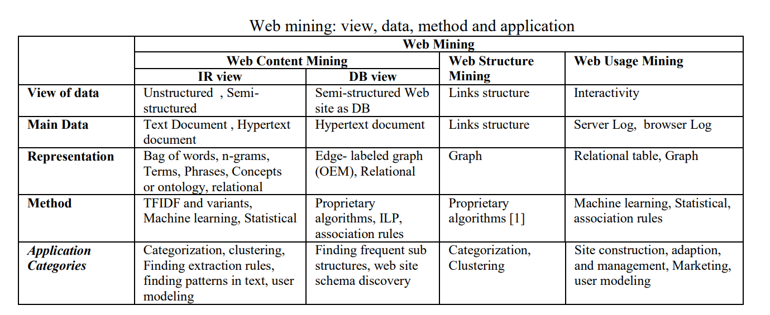
Web Mining : View , Data, Method and application

Slide 7
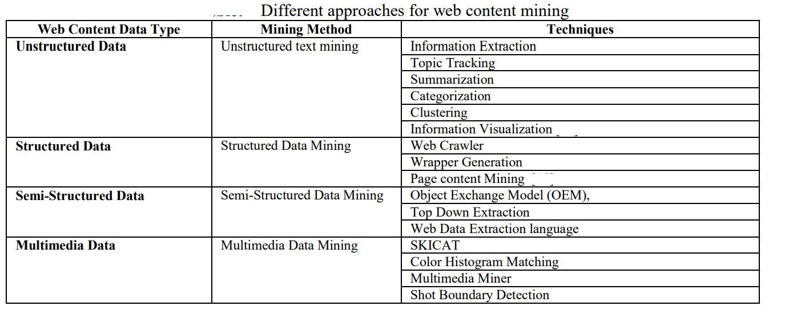
Different approaches for web content mining

